Slide 1

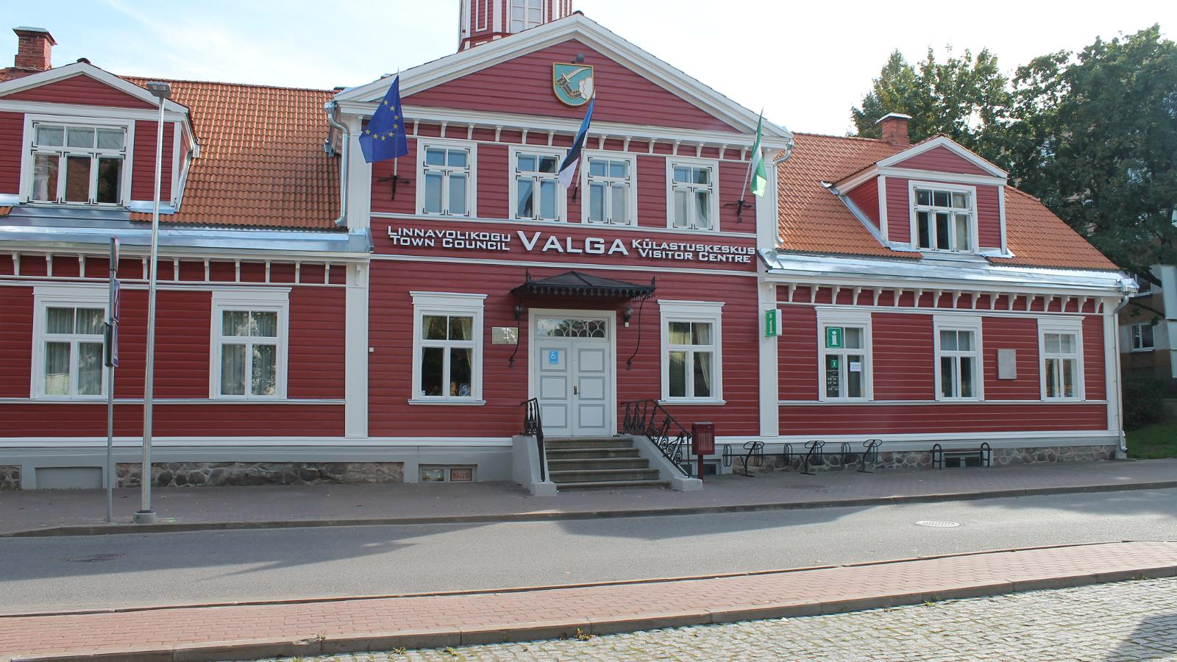
Team managers meeting
18.06.2021
The same building is your race office today on Friday in a first floor
and Doping control place in a second floor
The address is:
Puiestee 8, Valga, 68203 Valga county

Slide 2
Baltic Road Championships ’21 19-20.06.2021, Valga Estonia.
Baltic Road Championships '21 are organized by Estonian Cyclists Union in collaboration with Pro Cyclists Club and Liivimaa Cyclists Club.
Race director Allar Tõnissaar +372 501 4427 info@proklubi.ee
Assistant race director Rinaldo Teder +372 556 48230 rinaldo.teder@gmail.com
President of the Commissaire's Panel Jaan Lepajõe +372 534 25064 jaanlepajoe@gmail.com
Race secretary Evelin Idarand +372 536 05100 evelin.idarand@gmail.com
Estonian Cyclists Union' representative Urmas Karlson +372 502 4403 ejl@ejl.ee
Latvian Cycling Federation representative Toms Markss +371 262 55435 toms@lrf.lv
Lithuanian Cycling Federation representative Tomas Gaubys +370 686 3377 tomasgaubys22@gmail.com

Slide 3
Radio Tour: will be issued against a deposit of € 50 from race office !
Competition information is transmitted by Radio Tour transmitters on the frequency approved for EJL.
RadioTour chanel is: ???
Transmitters with code name Transmitters 1
Saturday race 10:00 /MSport, SEN1,SEN 2 / Team cars radios EST 5; LAT 5; LIT 5
need to be handed over to the next race to your own colleges
Saturday race 13:10/ M16
and again need to be handed over to you own next colleges
Saturday race 16:00/ MJUN
and finally back for charging to the race office !
Sunday race 10:00/ WE, WU, WJun;
Sunday race 13:00 /ME,MU;
and finally back for charging to the race office !

Slide 4
Radio Tour: will be issued against a deposit of € 50 from race office !
Competition information is transmitted by Radio Tour transmitters on the frequency approved for EJL.
RadioTour chanel is: 6
Transmitters with code name Transmitters 2
Saturday race 13:20 /SEN6,SEN 7; SEN 8 / Team cars radios EST 5; LAT 5; LIT 5
need to be handed over to the next race to your own college
Saturday race 16:10/ W16
and finally back for charging to the race office !

Slide 5
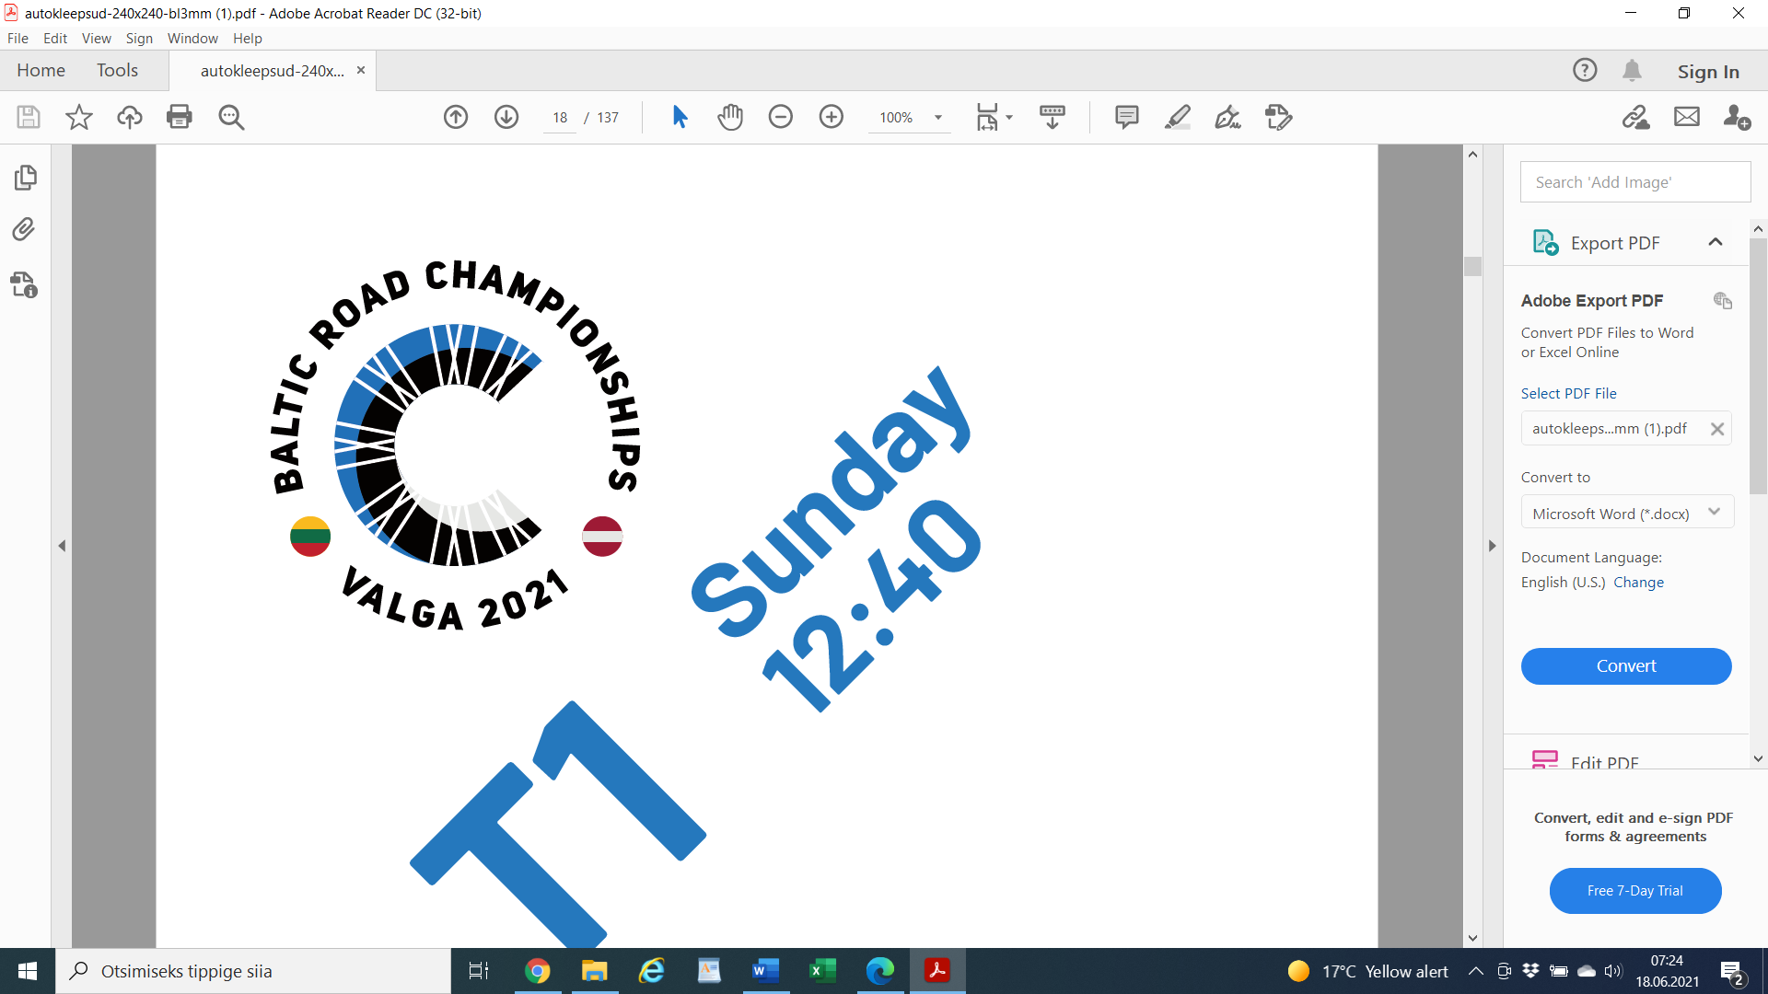
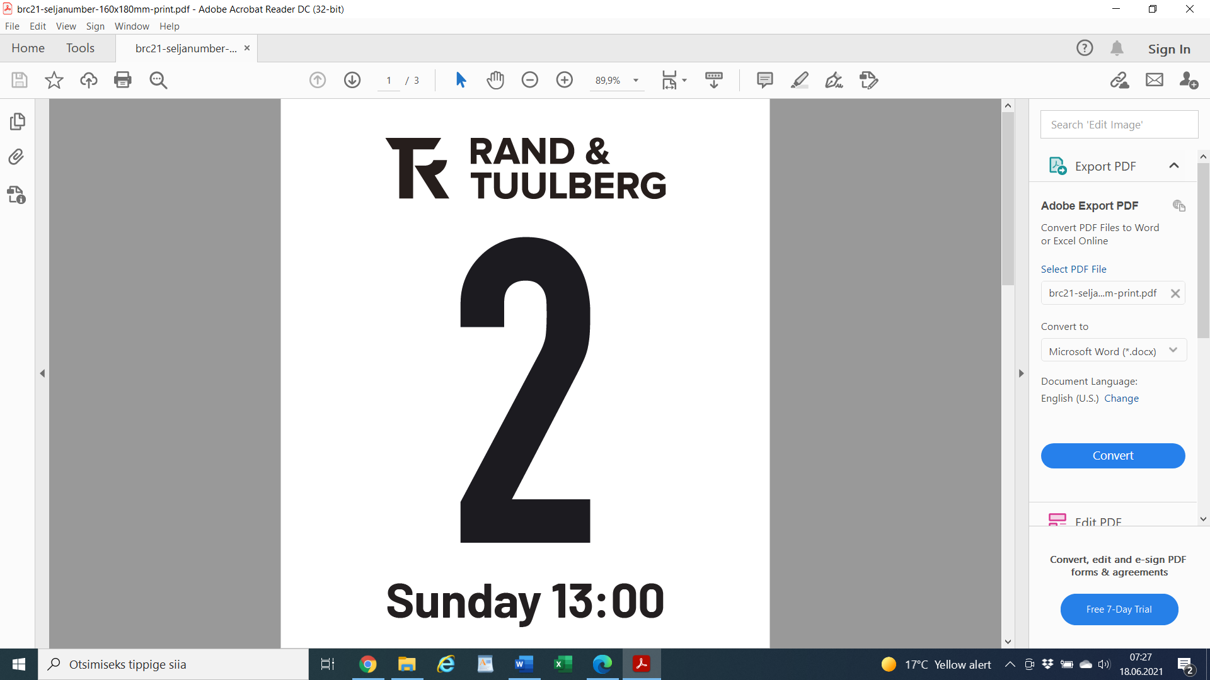
Car stickers and race numbers:
Will be issued together with race numbers from race office

Slide 6
Neutral technical support
The organizers will provide neutral technical assistance for road races.
The maximum number of team cars in the convoy is 15 per race. For each country there are 5 car places per race.
The drawing lots for team cars will be held at the end of the team managers meeting 18.06.21 10:00 using https://www.random.org/lists/ randomizer.
The order of team cars in the race will be determined as follows:
1. In between combined list of team cars presented to the organizing federation.
2. If the number on cars per race is less than 15 and team managers present a candidate at the team managers meeting for the free places a second order will determined in between these teams.
The driver of the escort car must have a valid UCI license.

Slide 7
Course maps:
Course maps definitions:
on Saturday 19.06 races
big (big) lap= https://www.google.com/maps/d/u/0/edit?mid=1rFiuF3siWsuCB6Lirh0TdvHe-niwJY6D&usp=sharing
3 km to the technical start+ 5,7 sart of the long lap inside of long lap+ 41 km + 2,5 km until the gravel section + gravel section 4 km+ 15,3 back to the finish line = 71,5 km
small lap = 10,9 km
on Sunday 20.06 races
Small big lap = 3 km + 5,7 + 2,5 + 4 km + 15,3 = 30,5 km
small lap = 10,9 km

Slide 8
Course maps:
Last 3 km is on a small lap and its similar in every race:
and may be its worth to look at that small video clip from Ampler Development Team facebook channel:
https://www.facebook.com/TeamAmpler/posts/175044831295756

Slide 9
Feeding
19.06 Saturday
10:00 M Sport/Amateurs; M Masters 30-49. Distance 112,7 km. From first feeding zone till last 20 km
13:10 M16. Distance 82,7 km. From first feeding zone end of long lap
13:20 M Masters 65-75+. Distance 32,7 km. On the 2nd short lap
16:00 MJ. Distance 112,7 km. From first feeding zone till last 20 km
16:10 W16. Distance 43,6 km. From the 2nd till the end of 3th short lap
20.06 Sunday
10:00 WJ, WE/WU, W Sport/amateurs, W Masters 30-59. Distance 82,5 km. From the first feeding zone till the end of 5th short lap
12:40 M Masters 50-64. Distance 82,5 km. From the 1st till the end of 5th short lap
13:00 ME/MU. Distance 178,1 km. From first feeding zone till the end of 5th short lap

Slide 10


Feeding and Trash zone signs:

Slide 11
Medical services
Medical assistance is provided at the start and finish site of the competition. During the competition the ambulance serving the event will drive behind the cars accompanying the peloton.
We have 2 ambulance cars serving the races one by one if there is two races in the same time
or both of them in a bigger races in a same time
There is a race doctor car in a bigger races
There is also a doctor in the competition centre all the time
Nearest hospital is Valga Haigla (Peetri street 2, Valga).

Slide 12
Official prize ceremony and Broadcast information
There will be 4 prize ceremonies every day after every race - check the exact program of the race !
Starting with BRC (Baltic Road Championships winners
Estonian Championship
Latvian Championship
Lithuanian Championship
Please help to ensure that your winners are delivered to the award podium area as soon as possible !
Especially on Sunday`s races as there is the direct online and TV broadcast
Broadcast information:
Broadcast information: Sunday from 10:00 - 13:00 / 15:00 - 17:30 ( ????)
TV broadcast: Sunday from 15:00 - 17:30 ( EST/LAT national TV)

Slide 13
Official prize ceremony
The winner of the race will be named Baltic champion and will be awarded with a prize from competition partners. The second and third place winners will be awarded with a prize from competition partners.
Official awards ceremony must be attended by all athletes who have won prizes in their age category. Athletes who do not appear for the award will lose their right to the prizes and may be fined in accordance with the UCI regulations.
Riders must present themselves in race clothing, wearing their team jersey and shall not wear a cap, headband, glasses or any other accessory until they leave the podium ceremony area.
ME/MU WE/WU/WJ/Wmas/Wamat MJ
I place 1 000 € I place 1 000 € I place 500 €
II place 600 € II place 600 € II place 300 €
III place 400 € III place 400 € III place 200 €

Slide 14
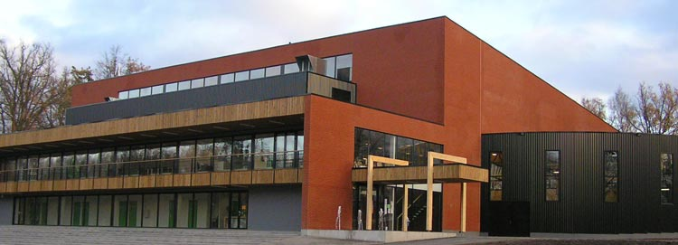
Washing facilities after the competition
19.06 ja 20.06 on an fluent basis from 11:00-19:00
called: Valga Sport Hall
address: Aadress: J.Kuperjanovi 36, Valga, 68207 Valga County
Phone: +372 766 1725

Slide 15
Covid-19
Social distancing of minimum 2m is expected at all times. Keep in mind that face masks on their own cannot provide complete protection against infection, and there is a need to use them alongside maintaining physical distance.
Regular hand washing/sanitizing is expected. Hand sanitizer will be provided at multiple locations on the event area.
It is the responsibility of the club/team representative or athlete to perform health checks. Participation in competitions for persons with symptoms (both competitors and competition organizers) is prohibited.
The organizer of the competition has the right to remove a person with symptoms and a person or persons who have been in contact with them from the competition if they have at least one of the Covid-19 symptoms.
COVID-19 symptoms
Fever > 38'C
Cough
Shortness of breath
Stuffy nose or sore throat
Unusual aches
Abnormal fatigue
Unusual headache
Diarrhea/vomiting

Slide 16
Anti-Doping
The UCI Anti-doping regulations are entirely applicable to the event.
The Anti-Doping station is located at The address is: Kesk11, Valga, 68203 Valga county/ second floor
All riders who are called to give samples to Anti-Doping are required to come to the testing place right after finish. Called riders will be announced via Sportity and Radio Tour.

Slide 17
Commissaires
Commissaire 1 - Jaan Lepajõe
Commissaire 2 - Mihkel Nanits
Commissaire 3 - Pait Peri
Motorcycle commissaire 1 - Arbo Aasoja
Motorcycle commissaire 2 - Edgari Treier
Broom wagon - Raul Aarma
Finish judge - Lia Rannamets
Radio tour - Raivo Maimre
Commissaire 1 - Raimo Ronimois
Commissaire 2 (moto) - Kairi Nuija
Commissaire 3 (moto) - Reikko Jents
Broom wagon - Raivo Rannamets

Slide 18
Technical guide
Technical guide is available here: https://www.ejl.ee/balticroad/.

Slide 19
Special notice
UCI regulations and penalty scale is applied
Gear regulations for W/M16 and W/MJ
W/M16 - 7.01 m
W/MJ - 7.93 m
Signature of the starting sheet
Technical support

Slide 20
Team cars draw
https://www.random.org/lists/
The order of team cars in the race will be determined as follows:
1. In between combined list of team cars presented to the organizing federation.
2. If the number on cars per race is less than 15 and team managers present a candidate at the team managers meeting for the free places a second order will determined in between these teams.
The driver of the escort car must have a valid UCI license.
Team cars allocated spaces are uploaded to Sportity.

Slide 21

Pre-race and current information is available in the Sportity app (www.sportity.com). Password is balticroad.
The results will be published at www.ejl.ee and the live results can be find on the timer's website timing.ee.

Slide 22
Thank you for your attention!

