Slide 1
EJL kohtunike seminar
3.-4. veebruaril 2018. a Roostal
Mida on uut võistlusmäärustes?
Madis Lepajõe
UCI komissar

Slide 2
Millest räägin
Muudatused võistlusmäärustes:
üldiselt
maanteel
cyclo-cross´is (muudatusi pole mõtet rääkida enne kui uue hooaja alguses, sest neid tuleb pärast iga hooaja lõppu )
küsimused-vastused

Slide 3
PART 1 GENERAL ORGANISATION
OF CYCLING AS A SPORT
§ 1 Licences (1)
1.1.006 ….
2a. Riders susceptible of taking part in events on the international calendar as well as national championships must be given a UCI ID which will appear on their licence. The national federation is responsible for ensuring that all riders susceptible of taking part in the aforementioned events are given a UCI ID.

Slide 4
PART 1 GENERAL ORGANISATION
OF CYCLING AS A SPORT
§ 1 Licences (2)
The UCI ID is provided by the UCI to the national federation at the time of the first relevant licence application by the rider and shall appear on any licence he may hold, regardless of the category or the national federation issuing the licence.
2b. All other riders may be given a UCI ID or may be given an identification number determined by the national federation, at the national federation’s discretion.

Slide 5
PART 1 GENERAL ORGANISATION
OF CYCLING AS A SPORT
1.1.022 Front (1)
UNION CYCLISTE INTERNATIONALE
NAME OF THE NATIONAL FEDERATION
1. Category for which the licence is requested UCI: national:
2. Surname and first name:
3. Date of birth:
4. Nationality:
5. Gender:
6. Email address:
......

Slide 6
PART 1 GENERAL ORGANISATION
OF CYCLING AS A SPORT
Form of licence
1.1.024
The text on the back of the licence is replaced by the following:
I agree to abide and be bound by the UCI Constitution and Regulations, in particular the UCI Anti-Doping Rules.
I also recognise the exclusive jurisdiction of the Court of Arbitration for Sport (CAS) in Lausanne, Switzerland, as provided for under the relevant provisions of the UCI Regulations.

Slide 7
PART 1 GENERAL ORGANISATION
OF CYCLING AS A SPORT
§ 4 Team managers' meeting
1.2.087 No more than 24 hours and no less than two hours before the start of the competition, the organiser must convene a meeting in a suitable room with the representatives of the organisation, the team managers, the commissaires and, where appropriate, the persons responsible for neutral vehicles and the services of public order, to coordinate their respective tasks and to take note of the specific characteristics of the event and safety measures as concern their own fields.

Slide 8
PART 1 GENERAL ORGANISATION
OF CYCLING AS A SPORT
§ 5 Entry check
1.2.090 Before the team managers' meeting as per article 1.2.087, the team manager - or his representative - must confirm the identity of the riders who will be starting to the commissaires' panel by signing the entry form (art. 1.2.050) and clearly highlighting the names of starting riders. The commissaires' panel shall check the licences of these riders and ensure that they are included on the list of entrants.

Slide 9
PART 1 GENERAL ORGANISATION
OF CYCLING AS A SPORT
§ 8 Race procedures
1.2.113
….
Whenever two races on the international calendar are organised on the same day and in the same location, the organiser may hold the official ceremony jointly for both races. The ceremony for the first race shall however be held no more than two hours after the finish.

Slide 10
PART 1 GENERAL ORGANISATION
OF CYCLING AS A SPORT
1.3.014
The plane passing through the highest points at the front and rear of the saddle can have a maximum angle of nine degrees from horizontal.
The length of the saddle shall be 24 cm minimum and 30 cm maximum. A tolerance of 5 mm is allowed.

Slide 11
PART 1 GENERAL ORGANISATION
OF CYCLING AS A SPORT
1.3.023
For riders that are 190 cm tall or taller, the horizontal distance between the vertical lines passing through the bottom bracket axle and the extremity of the handlebar extensions including all accessories may be extended to 85 cm.
Only one exemption for morphological reasons may be requested; either the handlebar extension can be moved forward or the peak of the saddle can be moved forward, in accordance with Article 1.3.013.

Slide 12
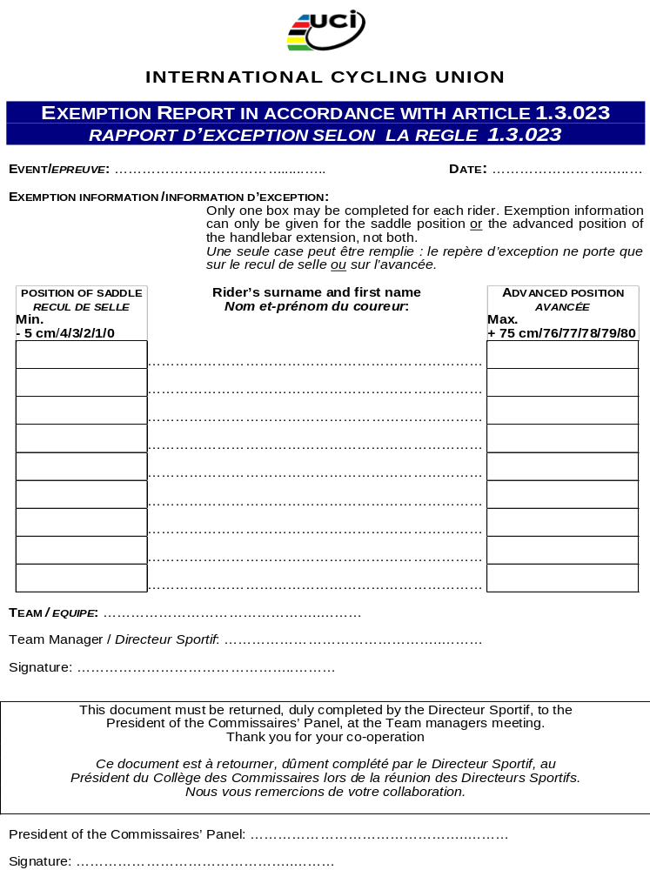

Slide 13
PART 1 GENERAL ORGANISATION
OF CYCLING AS A SPORT
1.3.024 ter (1)
Any bicycle may be fitted with onboard technology equipment that has the ability and purpose to collect or transmit data, information or images. Such equipment shall comprise telemetry and transponder units and video cameras. Bicycles may be fitted with such equipment under the following conditions:
- The system to install the equipment must be designed for use on bicycles and shall not affect the certification of any item of the bicycle;
- The system to install the equipment must not allow the equipment to be removed during the race and the equipment will be considered non-removable;

Slide 14
PART 1 GENERAL ORGANISATION
OF CYCLING AS A SPORT
1.3.024 ter (2)
- The rider must not have any direct access to the images or information concerning other riders being collected or transmitted during the race.
Compliance with the aforementioned conditions and provided all other provisions of the UCI Regulations are respected, means that the use of onboard technology is authorised but does not imply that the UCI undertakes any responsibility for it. The UCI shall not be liable for any consequences deriving from the installation and use of onboard technology by licence holders, nor for any defects it may hold or its non compliance.

Slide 15
PART 1 GENERAL ORGANISATION
OF CYCLING AS A SPORT
1.3.030 Rain capes’ design must be transparent or be similar to the jersey by use of one of the principle team colours. The team’s name must be displayed on it.
The aim of the amendment of this article is to emphasise the fundamental importance for all the stakeholders of cycling to be able to identify riders at all times:
o Riders should be able to identify their rivals at all times during a race in order to respect absolute equity and regularity between athletes;
o Commissaires must also be able to recognise the riders in order to make appropriate decisions regarding the sporting management of the event;
o TV directors and commentators can find it very difficult to identify riders; this is harmful to the image of professional cycling for spectators and fans who are following the race live.

Slide 16
PART 1 GENERAL ORGANISATION
OF CYCLING AS A SPORT
1.3.053 (N)
Advertising on a leader's jersey shall be reserved for the organiser of the race.
However, on the upper front and back of the jersey, in a rectangle 32 cm high and 30 cm wide, the lower 22 cm shall be reserved for use by the teams on a white background. The horizontal upper segment of the rectangle will match the lower point of the collar. The principal partner(s) of a team shall stand out there from all other advertisements.

Slide 17
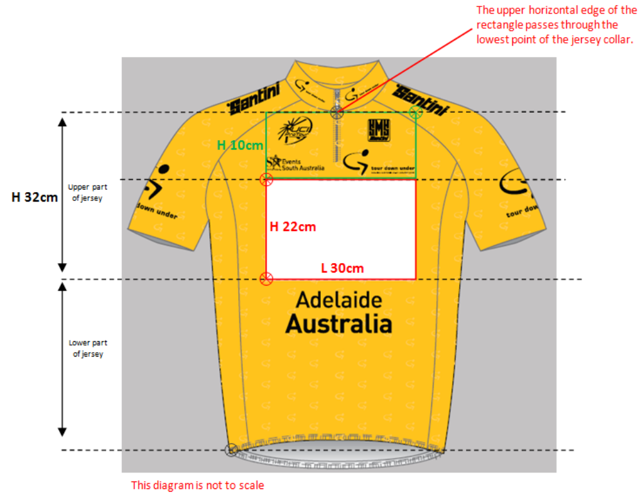
PART 1 GENERAL ORGANISATION
OF CYCLING AS A SPORT
1.3.053 (N)

Slide 18
PART 1 GENERAL ORGANISATION
OF CYCLING AS A SPORT
1.3.057 The following advertising shall be authorised:
• front of the jersey: 2 rectangular zones of 64 cm2 maximum;
• area comprising shoulders and sleeves: strip of maximum 5 cm high;
• on the sides of the jersey: a 9 cm wide strip;
• sides of the shorts: a 9 cm wide strip;
• the manufacturer's label (30 cm2) may appear once only on the jersey and once on each leg of the shorts.

Slide 19
PART 1 GENERAL ORGANISATION
OF CYCLING AS A SPORT
§ 8 Order of Priority
1.3.071
Without prejudice to relevant provisions but applicable for all the disciplines, should various provisions requiring the wearing of different jerseys apply to the same rider, the order of priority shall be as follows:
1. the leader's jerseys of the stage race
2. the world champion's jersey
3. the leader's jersey of the cup, series or UCI classification
4. the continental champion's jersey
5. the national champion's jersey
6. the national jersey

Slide 20
PART 1 GENERAL ORGANISATION
OF CYCLING AS A SPORT
Section 4: identification of riders
1.3.077
The identification numbers provided by the organiser shall be used by riders without any kind of alteration. They shall be issued free of charge by the organiser, after the rider's licence has been checked by the commissaires' panel.

Slide 21
PART 2 ROAD RACES
2.1.006
«MU» riders can participate in races classed as «ME». «MU» Races are reserved exclusively for riders of the «MU» category.
“WU” riders can participate in races classed as “WE”.

Slide 22
PART 2 ROAD RACES
2.2.002 The number of riders starting a road race shall be limited according to the following table:
World Championships 200
............
National Championships 200
............
UCI Europe Tour 176
............
National Calendars 176

Slide 23
PART 2 ROAD RACES
2.2.003
Without prejudice to specific provisions of the UCI Regulations (e.g. provisions in Part IX and XI regarding respectively the UCI Road World Championships and Olympic Games), the number of starting riders per team shall be set by the organiser, with a minimum of 4 and maximum of 7.
The organiser shall indicate in the programme or technical guide and on the entry form the number of starting riders per team for the event. This number shall be the same for all teams.

Slide 24
PART 2 ROAD RACES
2.2.003 bis
For all road races, without prejudice to Article 1.2.053, if the number of starting riders per team is set at 4, 5 or 6, a team may not start with less than 4 riders. If the number of starting riders per team is 7 or 8, a team may not start with less than 5 riders.
A team at the start of an event with fewer riders than the minimum established in the previous paragraph of this article may not start.

Slide 25
PART 2 ROAD RACES
2.2.010
In all road stage races on the international calendar, the organisers must cover the subsistence expenses of the teams from the night before the start to the final day; riders must stay in the hotels provided by the organiser throughout the entire duration of the race. Team support staff will be covered up to a number equal to the number of riders per team determined in the specific regulations for the event.

Slide 26
PART 2 ROAD RACES
2.2.015
Security
Inflatable structures (1)
(N) From 1st January 2022, inflatable structures on the road or crossing the road are prohibited, except in order to mark the position of the start line.

Slide 27
PART 2 ROAD RACES
Inflatable structures (2)
(N) Between 1st January 2018 and 1st January 2022, inflatable structures on the road or crossing the road are permitted only to mark the location of the start line, the last kilometre of the race and the finish line, subject to the following requirements:
- The structure must be equipped with two generators as well as two blowers working simultaneously; the structure must be maintained in a stable position even in case one of the two generators fails;

Slide 28
PART 2 ROAD RACES
Inflatable structures (3)
- At least one technician must stay on alert close to the structure in order to intervene if a problem occurs;
- At least one of the two blowers must be supplied with a thermic petrol generator;
- Petrol must be available next to the structure if necessary;
- The structure must be secured to at least 10 anchor points.

Slide 29
PART 2 ROAD RACES
Conduct of riders
2.2.025 (1)
Riders may not, without due care, jettison food, bonk-bags, feeding bottles, clothes, etc. in any place whatsoever.
Riders may not jettison anything on the roadway itself but shall draw to the side of the road and safely deposit the object there.
If waste zones are established by the organiser, the rider must safely and exclusively deposit their waste on the sides of the road in this area.

Slide 30
PART 2 ROAD RACES
Conduct of riders
2.2.025 (2)
Riders must not hold onto a vehicle or push off against a vehicle in order to gain a significant advantage. In addition to the sanction provided for in article 12.1.040, the disciplinary commission may impose a suspension of up to one month as well as a fine of CHF 200 to 5’000.

Slide 31
PART 2 ROAD RACES
Commissaires’ panel
2.2.028 bis
The race director or his representative able to take decisions takes place next to the president of the commissaires’ panel in the car driving immediately behind the peloton.

Slide 32
PART 2 ROAD RACES
Race incidents
2.2.029 (1)
In case of an exceptional accident or incident that could impinge upon the normal conduct of a race in general or a particular stage thereof, the race director may, after obtaining the agreement of the commissaires' panel and having informed the timekeepers, at any moment, decide:
- to modify the course,
- to temporarily neutralise the race or stage,
- to stop a race or a stage and restart the race or stage,
- to cancel a race or a stage.

Slide 33
PART 2 ROAD RACES
Race incidents
2.2.029 (2)
The president of the commissaires’ panel, after consulting the organiser, may take the following sporting decisions:
- cancel or let the results stand in case the race is temporarily neutralised or stopped, taking account of the gaps recorded at the moment of the incident;
- cancel or let the results stand of an intermediate sprint, mountain sprint or any classifications;
- declare a stage or a race null and void,

Slide 34
PART 2 ROAD RACES
Followers
2.2.035
It is of the organiser’s responsibility to make sure that all persons in a race convoy, except for accredited journalists and guests of honour who are not vehicle drivers, are licence holders.
Before the start of the race, the organiser must provide the president of the commissaires’ panel with a list of followers in the race convoy. This list must include the contact details of the followers as well as their national licence number and UCI ID.

Slide 35
PART 2 ROAD RACES
Press motorcade
2.2.056
The organisers shall demand that press vehicles be driven by experienced drivers, familiar with cycle races and knowing how to manoeuvre. It is of the organiser’s responsibility to make sure that these drivers hold the licence of a vehicle driver for a road event.
Before the start of the race, the organiser must provide the president of the commissaires’ panel with a list of press vehicles in the race convoy. This list must include the contact details of the drivers as well as their national licence number and UCI ID.

Slide 36
PART 2 ROAD RACES
Team managers’ meeting
2.2.093
(N) In accordance with article 1.2.087, the organiser must convene a team managers’ meeting.
Provisions for Women and Men events of class HC and class 1 as well as for the UCI Nations’ Cup events and UCI Womens’ WorldTour events
The meeting must take place at the following times:
- event starting before 12:00: the evening before at 17:00;
- event starting after 12:00: at 10:00 on the day of the race.

Slide 37
PART 2 ROAD RACES
Order of team cars
2.3.018 Other events (1)
1. the cars of UCI teams and of national teams represented at the sports directors’ meeting and having confirmed their starters within the time limits set out in article 1.2.090;
2. the cars of other teams represented at the sports directors’ meeting which confirmed their starters within the time set;

Slide 38
PART 2 ROAD RACES
Order of team cars
2.3.018 Other events (2)
3. the cars of teams represented at the sports directors’ meeting which failed to confirm their starters within the time set;
4. the cars of teams not represented at the sports directors’ meeting.
Within each group, the order of cars will be determined by drawing lots at the sports directors’ meeting.

Slide 39
PART 2 ROAD RACES
Level crossings
2.3.034
It shall be strictly forbidden to cross level crossings when the barrier is down or closing, the warning signal ringing or flashing.
Apart from risking the penalty for such an offence as provided by law, offending riders shall be eliminated from the competition by the commissaires; besides, the disciplinary commission may impose a suspension of up to one month as well as a fine of CHF 200 to 5’000.

Slide 40
PART 2 ROAD RACES
Official award ceremony (One day races)
2.3.046
Riders must take part in the official award ceremony based on the various classifications established by the organiser. The official ceremony will take place in the following order:
- The three first riders of the race;
- The other winners of the various other optional classifications;
- The leaders of UCI cups or UCI series.
No leader’s jersey of the race can be awarded during the official award ceremony.

Slide 41
PART 2 ROAD RACES
Leader’s jersey of the race and distinctive signs
2.6.018
......
The riders of the team leading the team classification shall be required to wear the corresponding distinctive bib number if required by the organiser.
The presentation of a team leader jersey is prohibited both in the protocol and in the race.
No leaders’ jersey of the race or distinctive sign can be worn by a rider during the first day (prologue or stage) of a stage race.

Slide 42
PART 2 ROAD RACES
Award ceremony (Stage races)
2.6.018 bis (1)
Riders must take part in the official award ceremony (prizes, jersey and distinctive signs) based on the various classification established by the organiser. The official ceremony will take place in the following order:
After each stage
- The winner of the stage;
- The leader of the general classification by time;
- The leaders of other classifications (except classification by teams);

Slide 43
PART 2 ROAD RACES
Award ceremony (Stage races) 2.6.018 bis (2)
After the last stage
- The winner of the stage;
- The winners of the other classifications (including classification by teams);
- The three first riders of the general classification by time;
- The leaders of UCI cups or series;
- All riders wearing a leader’s jersey.
Subject to prior information of the president of the commissaires’ panel, the organiser can modify the order for operational needs.

Slide 44
PART 2 ROAD RACES
Finish 2.6.027 (1)
In the case of a duly noted incident in the last three kilometres of a road race stage, the rider or riders affected shall be credited with the time of the rider or riders in whose company they were riding at the moment of the incident. His or their placing shall be determined by the order in which he or they actually cross the finishing line.
Is considered as an incident, any event independent from the physical capacity of the rider (fall, mechanical problem, puncture) and his will of remaining with the riders in whose company he was riding at the moment of the incident.

Slide 45
PART 2 ROAD RACES
Finish
2.6.027 (2)
Riders affected by an incident are asked to make themselves known to a commissaire by rising their hand and report to a commissaire after the finish of the stage.
If, as the result of a duly noted fall in the last three kilometres, a rider cannot cross the finishing line, he shall be placed last in the stage and credited with the time of the rider or riders in whose company he was riding at the time of the fall.

Slide 46
PART 2 ROAD RACES
Finishing deadline
2.6.032
......
In exceptional cases only, unpredictable and of force majeure, the commissaires panel may extend the finishing time limits after consultation with the organiser.
In case riders actually out of the time limit are given a second chance by the president of the commissaires panel, all points awarded in the general classifications of the various secondary classifications shall be withdrawn.

Slide 47
PART 12 DISCIPLINE AND PROCEDURES
12.1.013 bis (1)
All teams must ensure that all their bicycles are in compliance with the provisions of article 1.3.010. Any presence of a bicycle that does not comply with the provisions of article 1.3.010, within or on the margins of a cycling competition, constitutes a technological fraud by the team and the rider.
All riders must ensure that any bicycle that they use is in compliance with the provisions of article 1.3.010. Any use by a rider of a bicycle that does not comply with the provisions of article 1.3.010, within or on the margins of a cycling competition, constitutes a technological fraud by the team and the rider…

Slide 48
PART 12 DISCIPLINE AND PROCEDURES
12.1.040
2.3. Use or presence of a bicycle that does not comply with article 1.3.010 (cf. art. 12.1.013bis).
All categories of events:
- rider: disqualification
- team: disqualification

Slide 49
PART 12 DISCIPLINE AND PROCEDURES
12.1.040
4bis
Identification number replicated on a different support than the one provided by the organiser (art. 1.3.077).
All categories of events:
start refused

Slide 50
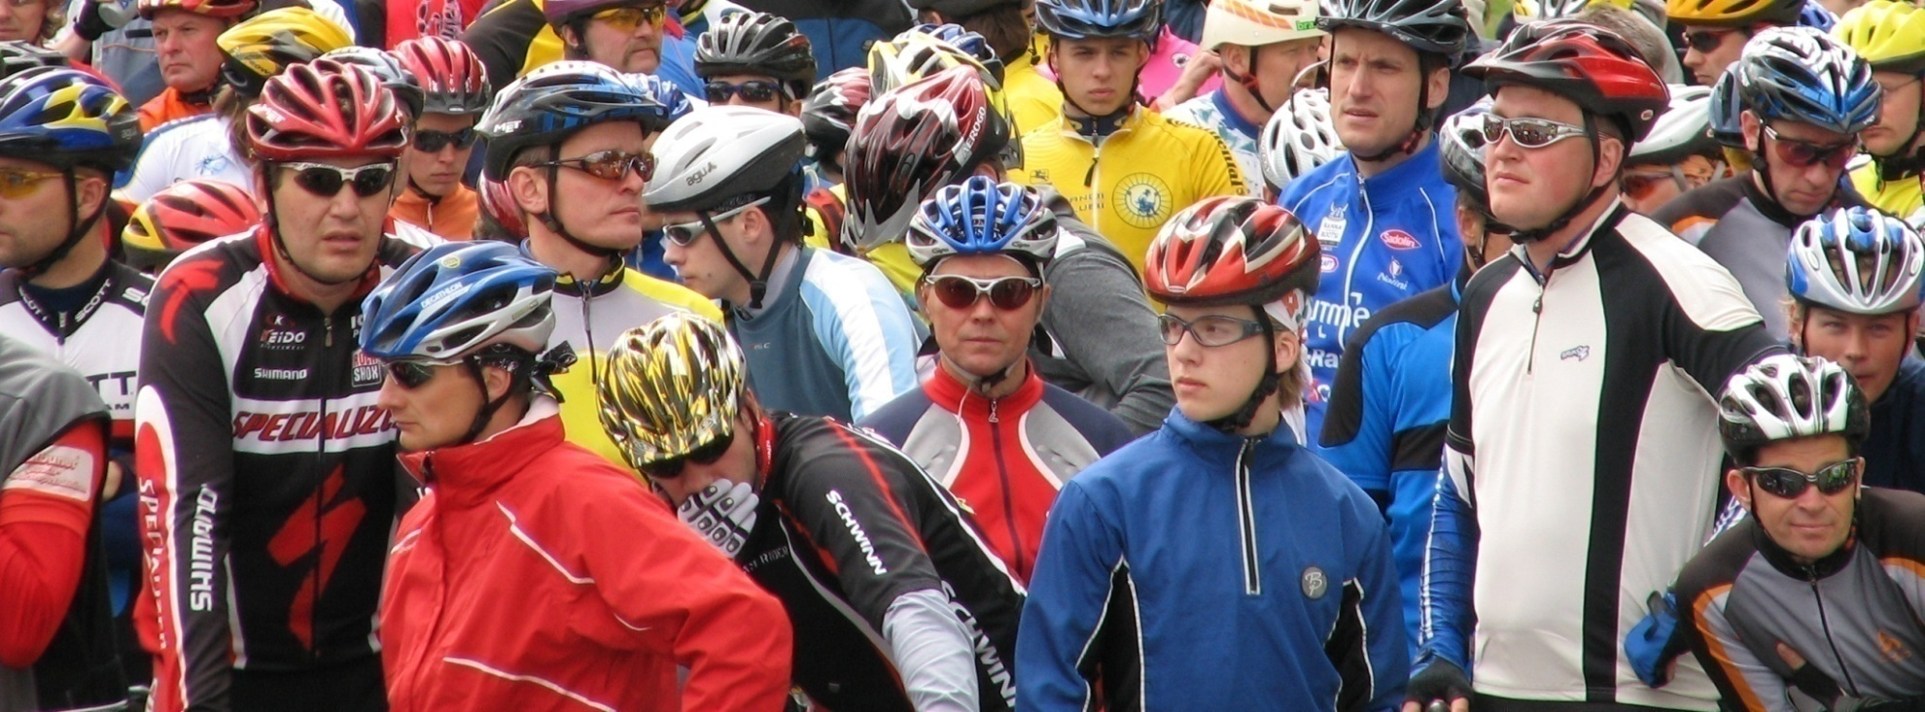
Tänan tähelepanu eest!

